Slide 1
CSE 708
PROJECT PRESENTATION
Name: Md. Samiel Islam Sami
Id: 21301002

Slide 2
A Comparative Survey of Minimum Spanning Tree
Algorithms: Classical Approaches, Recent
Improvements, and Real-World Applications

Slide 3
Introduction:
Presents a comparative survey of classical MST algorithms, highlighting their structure and practical characteristics.
Introduces recent developments in MST,
Addresses the limitations of classical approaches, in parallel, distributed, and dynamic large-scale MST computation.
Showcases the real-world applications and usage of MST.
A Minimum Spanning Tree (MST) is a subset of edges from a connected, undirected, weighted graph that connects all vertices together without cycles and with the minimum possible total edge weight. It retains all vertices but uses exactly V-1 edges (where V is the number of vertices).
Key Properties:
Acyclic
Connected
Minimum Weight

Slide 4
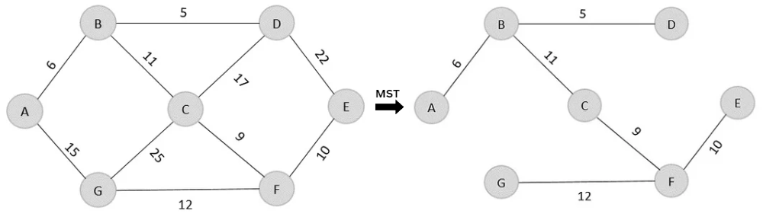
Kruskal’s Algorithm
1) Sort all edges in ascending order of weight.
2) Start with an empty set of selected edges.
3) Select the next lightest edge.
4) Add the edge if it does not form a cycle.
5) Continue until (V − 1) edges have been selected.

Slide 5
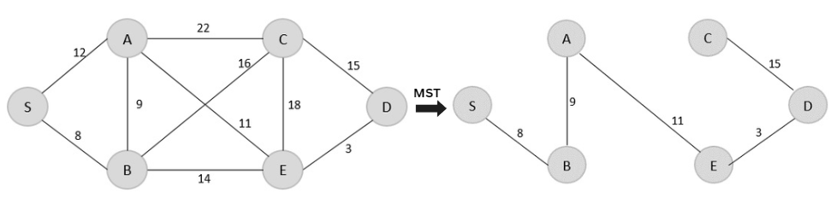
Prim’s Algorithm
1) Select an arbitrary starting vertex.
2) Identify the minimum-weight edge connecting the current tree to an unvisited vertex.
3) Add that edge and vertex to the tree.
4) Update the candidate edges.
5) Repeat until all vertices are included.

Slide 6
RECENT IMPROVEMENTS
Massively Parallel and Distributed MST Algorithms: One of the major limitations of classical MST algorithms is that their standard implementations are primarily designed for sequential execution.
Dynamic and Incremental Minimum Spanning Trees: Classical MST algorithms usually assume that the input graph remains unchanged during computation. However, we know that many real-world networks are dynamic.
Approximate and Learning-Augmented MST Algorithms: A recent development is the use of approximation and data-driven techniques for MST problems in metric spaces.
Hardware-Specific and Emerging Approaches: MST computation is also being investigated on specialized hardware architectures. Neuromorphic MST computation is an emerging concept.
REAL-WORLD APPLICATION
Computer and Communication Networks
Transportation and Infrastructure
Network and Power
Image Processing
Clustering and Data Analysis

Slide 7
Conclusion
This survey examined the development of MST algorithms from classical greedy approaches to recent research
Addressed the challenges of modern large-scale graph processing.
Modern MST research is concerned with scalability, adaptability, and practical performance.
Combining MST computation with approximation, machine learning, and hardware-aware optimization also showed promise.
MST techniques are commonly used in communication networks, transportation and infrastructure planning, networks, image processing, and many others.
Future research should therefore focus on developing MST algorithms that can efficiently handle increasingly large and continuously changing graphs.

